Slide 1
Payroll System
Team 6 – Jasper, Sridhar, SRV, Rakshitha, Rajitha, Manasa, Nishchey, Vikas

Slide 2
Introduction
Payroll system is to automate payroll management in Virtusa.
To keep track of their employees complete payroll information.
Employees can login and go through their payroll information.

Slide 3
Scope
Payroll System is intended to allow each and every employee of the organization to view their payroll information.
The employee need not register themselves with the system, he/she can access the system with his employee id and password.

Slide 4
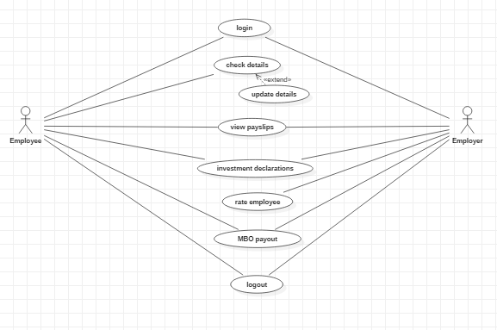
Usecase Diagram

Slide 5
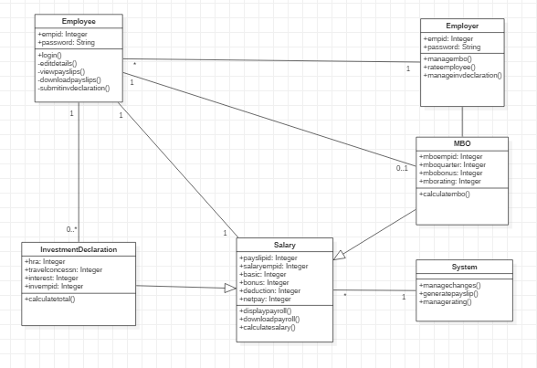
Class Diagram

Slide 6
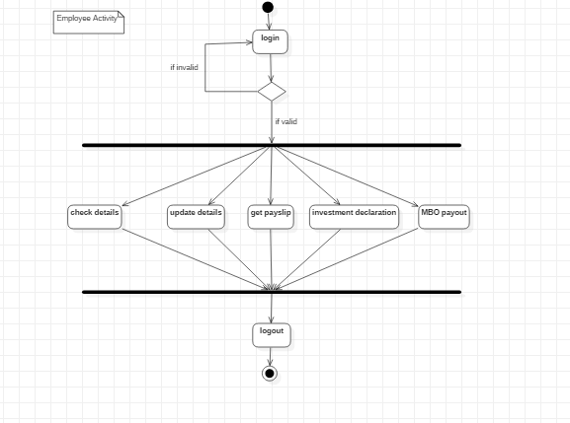
Activity Diagram - Employee

Slide 7
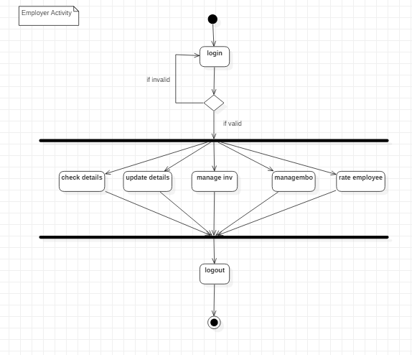
Activity Diagram – Employer

Slide 8
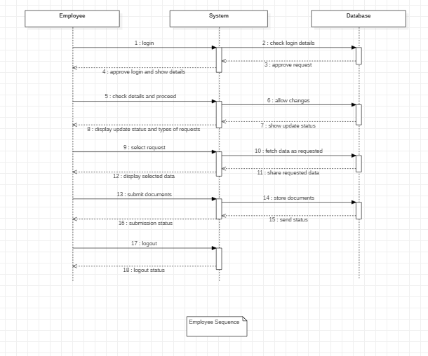
Sequence Diagram – Employee

Slide 9
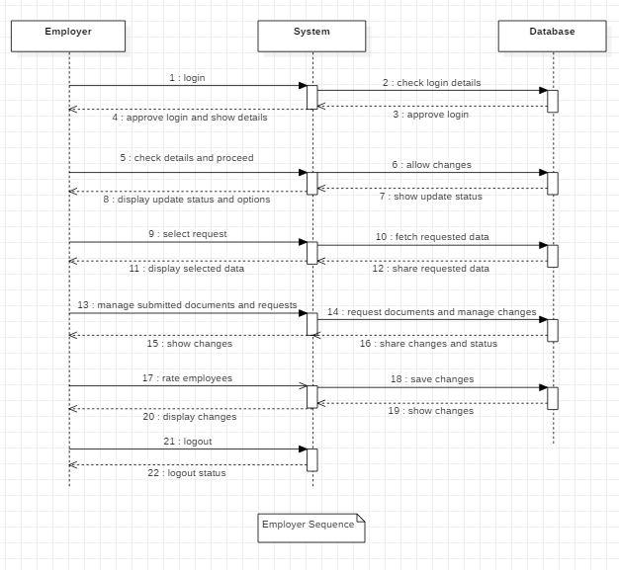
Sequence Diagram - Employer

Slide 10
Thank you

